Slide 1
Software Design Patterns Team project “Minesweeper”
Participants: Alsalim, Maxim, Makhambet

Slide 2
Goals of the Project
Goal: using software patterns implement “minesweeper” game; connect all patterns in one working structure; implement logic and architecture of project.

Slide 3
Architecture
The project is structured using the MVC (Model-View-Controller) architectural pattern to separate logic, interface, and game event management. Main components include:
* Model: Manages game logic, including grid layout, cell states, and game rules.
* View: Displays the game board, updates cell status, and provides feedback.
* Controller: Accepts user input, directs requests to the Model, sets timer, and updates the View.

Slide 4
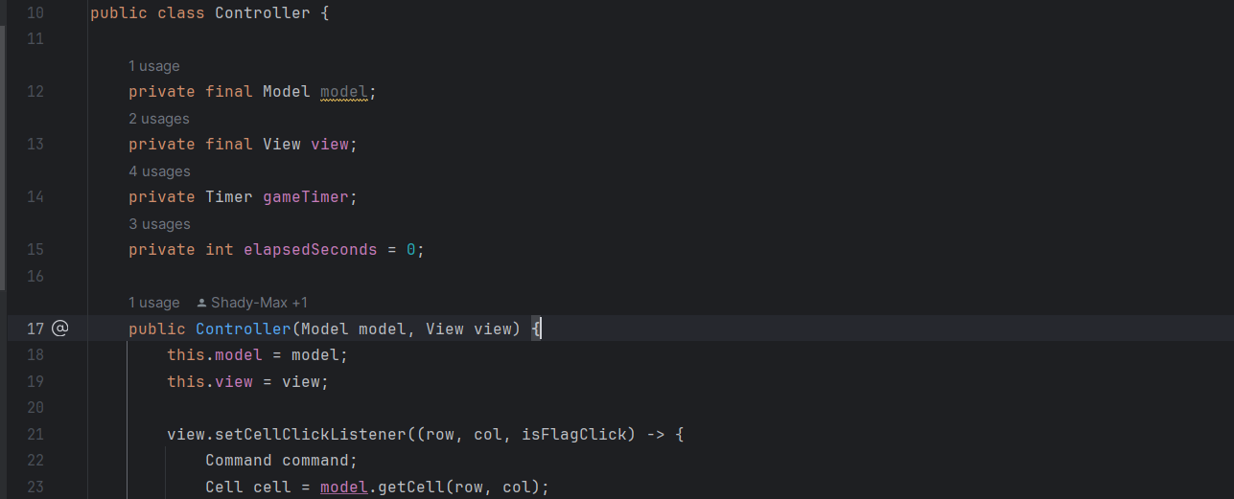
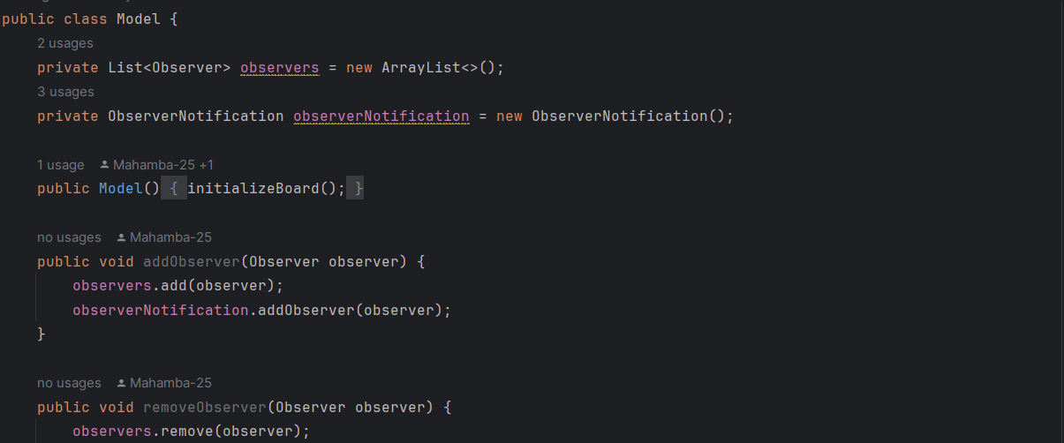
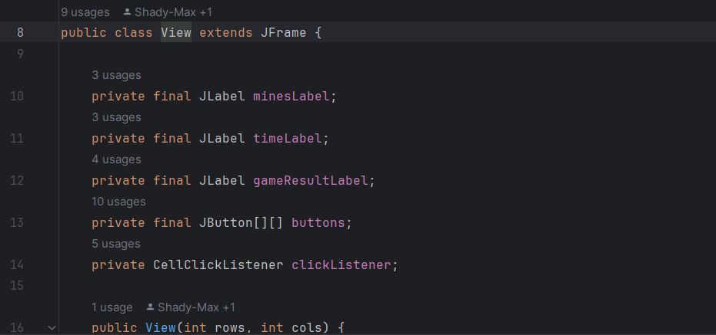
Architecture
Controller
Model
View

Slide 5
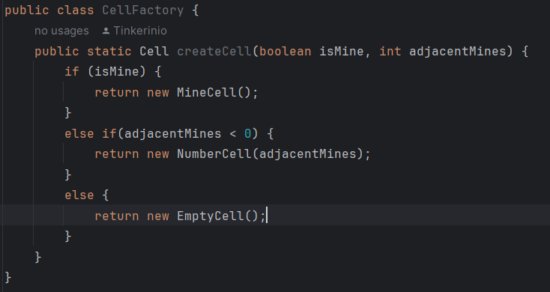
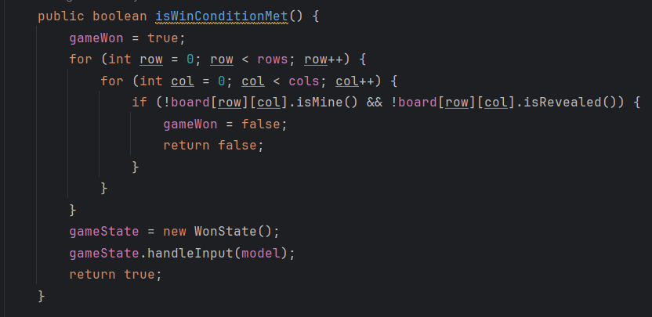
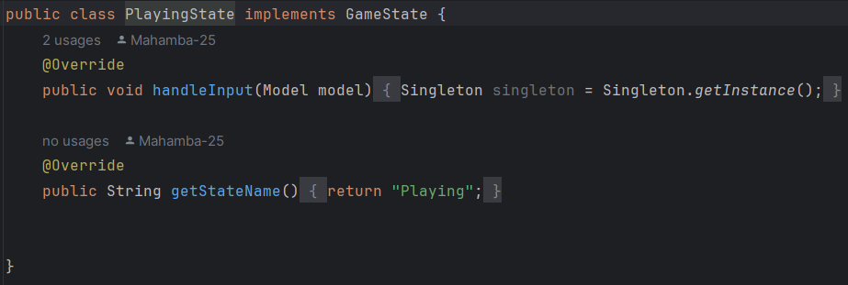
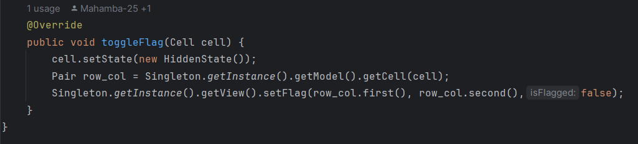
Key functions

Slide 6
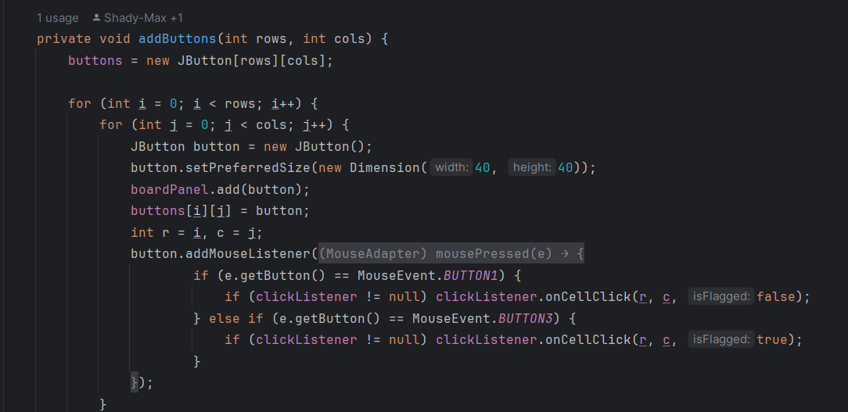
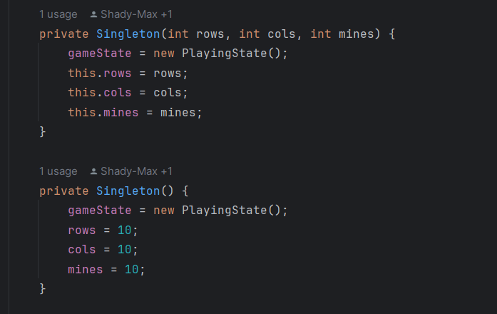
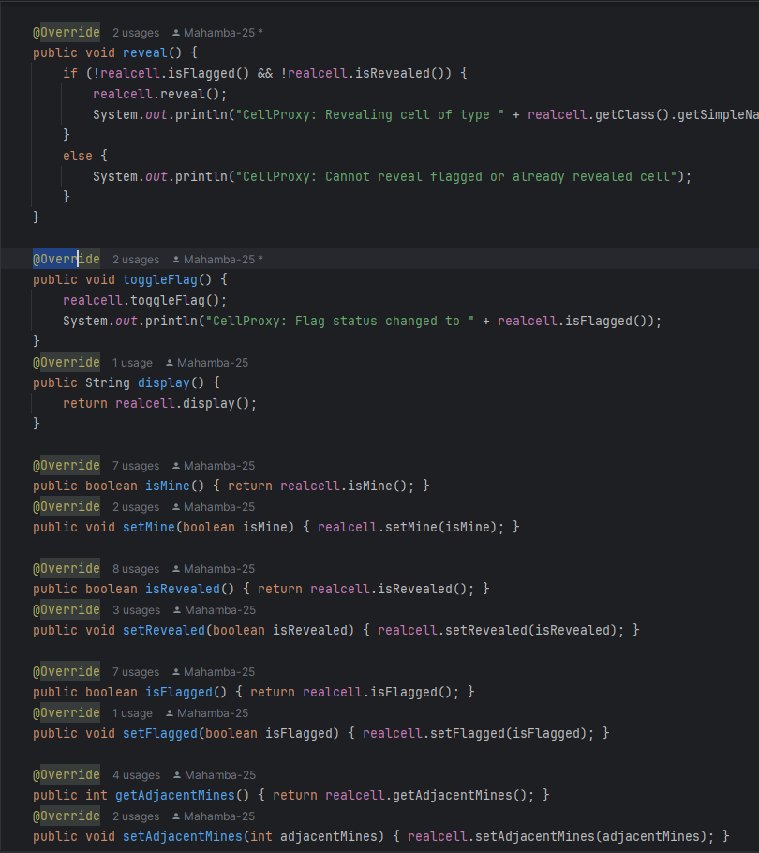
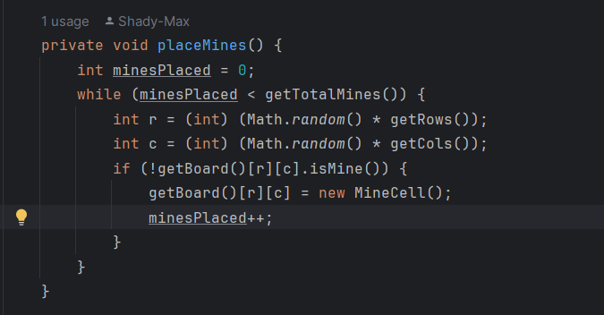
Key functions

Slide 7
Challenges and their solutions
Problem 1: Implementing abstract class functions with other patterns and connection structure with other constructions
Solution: We rewrite block code for implementing new functions connected with abstract class
Problem 2: Implementing State pattern lead to buttons to be inactive after restarting the game
Solution: Adding Singleton.getInstance() to both LostState and WinState methods

Slide 8
Lessons learned
Do not use too many patterns due to conducting problems with productivity of the project
Patterns implementation causes a convenient development of the project
Theme of project should be capable for implementing software patterns
Team work requires a lot of intuitive understanding and discussing for coming to one conclusion in terms of writing code

